Slide 1
Unit 8

Slide 2
Serial Communication
In serial communication, data transmission occurs bit by bit on a single communication line or channel.
This process means that data bits are sent one after the other in a sequence or series (hence the term 'serial'), with the receiving device collecting and reassembling these bits into a complete message.
In simple terms, serial data transmission is like a single-lane road where cars can only travel one after the other, not side by side.
Here is a simple breakdown of how serial data is transmitted:

Slide 3
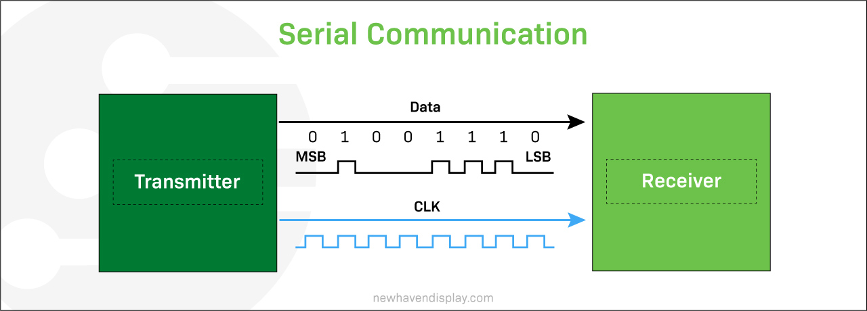
Start of communication: The device sending the data, called the transmitter, sends a start bit to the device receiving the data, known as the receiver.
The start bit is like a heads-up, signaling, "Hey, I'm about to send some data."
Data transmission: Next, the transmitter sends the data bit by bit in a specific order.
It's like sending a long message, one letter at a time.
End of communication: When all the data bits have been sent, the transmitter sends a stop bit, saying, "That's it, I've sent everything I had to send."
Error checking (optional): The receiver then checks if it has received the data correctly.
This is done through a process known as parity checking.
If the data isn't correct, the receiver can ask the transmitter to resend the data.

Slide 4
The telegraph was one of the first devices for long-distance serial communication, using a single wire to transmit data.
Serial communication protocols and standards began to develop in the 1960s. These protocols, such as RS-232, SPI, I²C, RS485, USB, and MIPI, are widely used in electronic circuits, LCDs, OLEDs, computer systems, embedded systems, and telecommunications.

Slide 5
Serial Communication Advantages
Serial communication requires fewer lines or wires than parallel communication, which leads to lower implementation costs, less complex hardware, and simpler data transfer processes over long distances, making it the preferred choice for telecommunication networks.
Serial Communication Disadvantages
Serial communication can be slower than parallel communication.
It can only transmit a certain amount of data per unit of time, which limits bandwidth.
Serial communication has a higher processing overhead because the data has to be organized, synchronized, and packaged before sending, and once it reaches the receiver, it needs to be decoded.

Slide 6
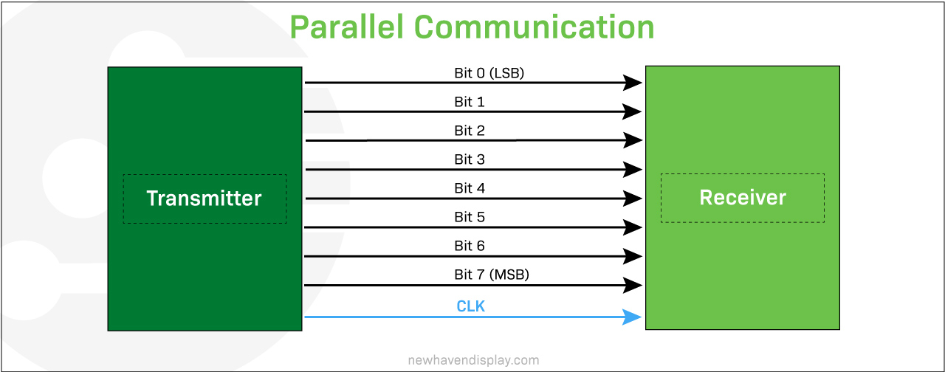
Parallel Communication
Parallel communication is a method of transmitting data in which multiple bits are sent simultaneously over multiple channels or cables.
These bits are generally sent in data groups of 8 bits, known as bytes, in a single clock pulse.
This means each bit is transmitted over a dedicated cable.
This technique is like a multi-lane highway, with each 'bit' having its own lane, allowing for simultaneous data transmission.
Here is a simple breakdown of how parallel data is transmitted:
Start of communication: The transmitter signals the receiver about data transmission readiness.
Data transmission: The data is divided into multiple bit groups, and the transmitter sends all the bits simultaneously over separate communication lines or cables.
Data reception: The receiver gets all the data streams and arranges them in the correct order to reconstruct the original data.
End of communication: Once all parallel bits are received, and data is reconstructed, the communication is complete.
Error checking (optional): Some systems may use error-checking mechanisms to verify data accuracy.

Slide 7
Parallel communication is typically faster than serial communication, as it can transmit more data in the same amount of time.
However, it is also more complex and requires more hardware.
Parallel communication is often used in applications where high data rates are required, such as in printers, scanners, and external hard drives.
It is also used in some internal computer buses, such as the PCI bus.

Slide 8
Parallel Communication Advantages
Parallel communication offers fast data transfer rates, making it optimal for high data rate demands like printers, scanners, and external drives.
Over short distances, parallel communication is less prone to errors and simplifies data synchronization because it transmits multiple bits simultaneously.
This is a crucial aspect of digital audio and video applications.

Slide 9
Parallel Communication Disadvantages
Parallel communication requires multiple communication channels, which increases cost, size, and data processing operations.
Over longer distances, parallel communication can suffer from 'skew' as signals on different wires can arrive at different times.
Because parallel communication sends data over multiple lines in close proximity, there is a chance of crosstalk which can cause errors.

Slide 10
Serial Vs Parallel communication summary:
 | Serial | Parallel
Speed | Typically slower for short distances than parallel communication. | Typically faster as multiple bits are sent at once
Complexity | Simple for long distances | Simple for short distances
Cost | Typically cheaper for long distances | Typically more expensive for long connections
Reliability | Reliable over long distances | May suffer signal degradation over long distances
Interference | Less prone to crosstalk | More prone to crosstalk in longer connections
Synchronization | Complex at very high speeds | Easier to synchronize at short distances
Scalability | High-speed scalability can be challenging | Can be easily scaled for short distances
Wiring | Requires fewer wires, reducing bulk | Requires more wires, increasing bulk
Bandwidth | Bandwidth limited by channel characteristics | High bandwidth potential

Slide 11
Mode of Transfer:
The binary information that is received from an external device is usually stored in the memory unit.
The information that is transferred from the CPU to the external device is originated from the memory unit.
CPU merely processes the information but the source and target is always the memory unit.
Data transfer between CPU and the I/O devices may be done in different modes.
Data transfer to and from the peripherals may be done in any of the three possible ways
Programmed I/O.
Interrupt- initiated I/O.
Direct memory access( DMA).
I\O processor

Slide 12
Programmed I/O:
It is due to the result of the I/O instructions that are written in the computer program.
Each data item transfer is initiated by an instruction in the program. Usually the transfer is from a CPU register and memory.
In this case it requires constant monitoring by the CPU of the peripheral devices.
Example of Programmed I/O: In this case, the I/O device does not have direct access to the memory unit.
A transfer from I/O device to memory requires the execution of several instructions by the CPU, including an input instruction to transfer the data from device to the CPU and store instruction to transfer the data from CPU to memory.
In programmed I/O, the CPU stays in the program loop until the I/O unit indicates that it is ready for data transfer.
This is a time consuming process since it needlessly keeps the CPU busy.
This situation can be avoided by using an interrupt facility. This is discussed below.

Slide 13
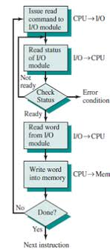

Slide 14
Interrupt- initiated I/O:
Since in the above case we saw the CPU is kept busy unnecessarily.
This situation can very well be avoided by using an interrupt driven method for data transfer.
By using interrupt facility and special commands to inform the interface to issue an interrupt request signal whenever data is available from any device.
In the meantime the CPU can proceed for any other program execution.
The interface meanwhile keeps monitoring the device. Whenever it is determined that the device is ready for data transfer it initiates an interrupt request signal to the computer.
Upon detection of an external interrupt signal the CPU stops momentarily the task that it was already performing, branches to the service program to process the I/O transfer, and then return to the task it was originally performing.
The I/O transfer rate is limited by the speed with which the processor can test and service a device.
The processor is tied up in managing an I/O transfer; a number of instructions must be executed for each I/O transfer.

Slide 15
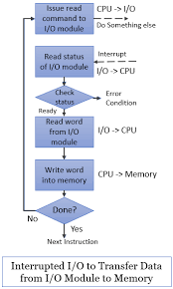

Slide 16
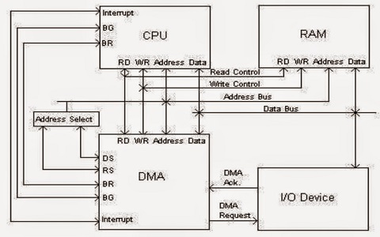
DMA

Slide 17
What is Interrupt?
The interrupt is a signal emitted by hardware or software when a process or an event needs immediate attention.
It alerts the processor to a high-priority process requiring interruption of the current working process.
In I/O devices one of the bus control lines is dedicated for this purpose and is called the Interrupt Service Routine (ISR).
When a device raises an interrupt at let’s say process i, the processor first completes the execution of instruction i.
Then it loads the Program Counter (PC) with the address of the first instruction of the ISR.
Before loading the Program Counter with the address, the address of the interrupted instruction is moved to a temporary location.
Therefore, after handling the interrupt the processor can continue with process i+1.
While the processor is handling the interrupts, it must inform the device that its request has been recognized so that it stops sending the interrupt request signal.
Also, saving the registers so that the interrupted process can be restored in the future, increases the delay between the time an interrupt is received and the start of the execution of the ISR.
This is called Interrupt Latency.

Slide 18
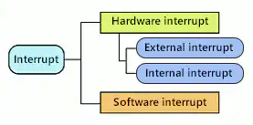
Interrupt Type
Interrupts have two types:
Hardware interrupt and Software interrupt.
The hardware interrupt occurs by the
interrupt request signal from peripheral circuits.
On the other hand, the software interrupt occurs by executing a dedicated instruction.

Slide 19
Types of Interrupt
Event-related software or hardware can trigger the issuance of interrupt signals.
These fall into one of two categories: software interrupts or hardware interrupts.
Hardware Interrupts:
If the signal for the processor is from external device or hardware is called hardware interrupts.
Example: from keyboard we will press the key to do some action this pressing of key in keyboard will generate a signal which is given to the processor to do action, such interrupts are called hardware interrupts.
Hardware interrupts can be classified into two types they are
Maskable Interrupt: The hardware interrupts which can be delayed when a much highest priority interrupt has occurred to the processor.
Non Maskable Interrupt: The hardware which cannot be delayed and should process by the processor immediately.

Slide 20
The hardware interrupt has an
External interrupt and
Internal interrupt.
External Interrupt:
The external interrupt occurs when a specified signal is input to the dedicated external interrupt terminal.
Some examples that cause external interrupts:
I/O devices requesting transfer of data
I/O devices finished the transfer of data. When a program executes in an endless loop and thus exceeds its time limit, an external interrupt occurs which is Timeout Interrupt.
While transferring the CPU’s complete state to a non-destructive memory in a few milliseconds before power ceases, then an external interrupt occurs.

Slide 21
Internal Interrupt
The internal interrupt occurs by an interrupt request signal from a peripheral circuit built into the microcontroller.
In addition, it has a maskable interrupt and a non maskable interrupt depending on how the interrupt request signal is received.
Some examples that cause external interrupts:
Register Overflow.
Attempt to divide by zero
Invalid operation code.
Stack overflow.
Protection violation.
These conditions usually occur because of premature termination of the instruction execution.

Slide 22
1. Software Interrupts
A sort of interrupt called a software interrupt is one that is produced by software or a system as opposed to hardware.
Traps and exceptions are other names for software interruptions.
They serve as a signal for the operating system or a system service to carry out a certain function or respond to an error condition.
Generally, software interrupts occur as a result of specific instructions being used or exceptions in the operation.
In our system, software interrupts often occur when system calls are made.
In contrast to the fork() system call, which also generates a software interrupt, division by zero throws an exception that results in the software interrupt.
A particular instruction known as an “interrupt instruction” is used to create software interrupts.
When the interrupt instruction is used, the processor stops what it is doing and switches over to a particular interrupt handler code.
The interrupt handler routine completes the required work or handles any errors before handing back control to the interrupted application.

Slide 23
Difference between External Interrupts vs Internal Interrupts
External Interrupts | Internal Interrupts
External interrupts are caused by some external event or failure. | Internal interrupts are caused by some exceptional condition caused by program itself rather than by an external event.
External interrupts are asynchronous. | Internal interrupts are synchronous with the program.
External interrupts depend on external conditions that are independent of the program being executed at that time. | If the program is returned, Internal interrupts will occur in the same place each time.

Slide 24
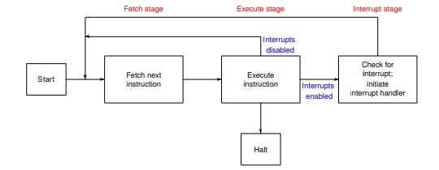
Interrupt Stages and Processing.
Instruction cycle consists of fetch, execute and interrupt stage show in below diagram −
If any interrupt occurs, it is indicated by an interrupt flag.
The CPU will go to interrupt handler routine.
Interrupt handler then checks the type of interrupt and executes the appropriate function.
It involves overhead but still better than the CPU waiting for I/O completion or other activities.
Interrupt handler activates most prior able activity first and later deferrable part will be handled.

Slide 25
Interrupt processing
Step 1 − First device issues interrupt to CPU.
Step 2 − Then, the CPU finishes execution of current instruction.
Step 3 − CPU tests for pending interrupt request. If there is one, it sends an acknowledgment to the device which removes its interrupt signal.
Step 4 − CPU saves program status word onto control stack.
Step 5 − CPU loads the location of the interrupt handler into the PC register.
Step 6 − Save the contents of all registers from the control stack into memory.
Step 7 − Find out the cause of interrupt, or interrupt type or invokes appropriate routine.
Step 8 − Restore saved registers from the stack.
Step 9 − Restore PC to dispatch the original process.

Slide 26
Priority Interrupts
(S/W Polling and Daisy Chaining)
when I/O devices are ready for I/O transfer, they generate an interrupt request signal to the computer.
The CPU receives this signal, suspends the current instructions it is executing, and then moves forward to service that transfer request.
But what if multiple devices generate interrupts simultaneously.
In that case, we have a way to decide which interrupt is to be serviced first.
In other words, we have to set a priority among all the devices for systemic interrupt servicing.
The concept of defining the priority among devices so as to know which one is to be serviced first in case of simultaneous requests is called a priority interrupt system.
This could be done with either software or hardware methods.
SOFTWARE METHOD – POLLING
HARDWARE METHOD – DAISY CHAINING

Slide 27
SOFTWARE METHOD – POLLING
In this method, all interrupts are serviced by branching to the same service program.
This program then checks with each device if it is the one generating the interrupt.
The order of checking is determined by the priority that has to be set.
The device having the highest priority is checked first and then devices are checked in descending order of priority.
If the device is checked to be generating the interrupt, another service program is called which works specifically for that particular device.
The major disadvantage of this method is that it is quite slow. To overcome this, we can use hardware solution, one of which involves connecting the devices in series. This is called Daisy-chaining method.
The structure will look something like this-

Slide 28
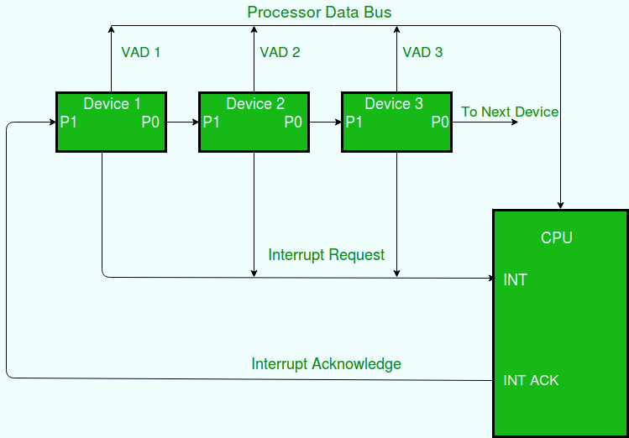
HARDWARE METHOD – DAISY CHAINING
The daisy-chaining method involves connecting all the devices that can request an interrupt in a serial manner.
This configuration is governed by the priority of the devices.
The device with the highest priority is placed first followed by the second highest priority device and so on.
The given figure depicts this arrangement.

Slide 29
WORKING:
There is an interrupt request line which is common to all the devices and goes into the CPU.
When no interrupts are pending, the line is in HIGH state. But if any of the devices raises an interrupt, it places the interrupt request line in the LOW state.
The CPU acknowledges this interrupt request from the line and then enables the interrupt acknowledge line in response to the request.
This signal is received at the PI(Priority in) input of device 1.
If the device has not requested the interrupt, it passes this signal to the next device through its PO(priority out) output. (PI = 1 & PO = 1)
However, if the device had requested the interrupt, (PI =1 & PO = 0)
The device consumes the acknowledge signal and block its further use by placing 0 at its PO(priority out) output.
The device then proceeds to place its interrupt vector address(VAD) into the data bus of CPU.
The device puts its interrupt request signal in HIGH state to indicate its interrupt has been taken care of.
If a device gets 0 at its PI input, it generates 0 at the PO output to tell other devices that acknowledge signal has been blocked. (PI = 0 & PO = 0)
Hence, the device having PI = 1 and PO = 0 is the highest priority device that is requesting an interrupt.
Therefore, by daisy chain arrangement we have ensured that the highest priority interrupt gets serviced first and have established a hierarchy.
The farther a device is from the first device, the lower its priority.

